Slide 1
CHAPTER # 01: OPERRATING SYSTEM - INTRODUCTION
BSCS-IV

Slide 2
CONTENTS
What Operating Systems Do
Computer-System Organization
Computer-System Architecture
Operating-System Operations
Resource Management
Security and Protection
Virtualization
Computing Environments

Slide 3
OPERATING SYSTEM!
RESOURCE ALLOCATOR, CONTROLLER and INTERMEDIATORY LAYER

Slide 4
01
WHAT OPERATING SYSTEMS DO!

Slide 5
WHAT OPERATING SYSTEMS DO!
01
02
03
04
COMMUNICATION
EFFICIENCY
Interface between User and Hardware.
Use the computer hardware in an efficient manner.
USABILITY
PROGRAM EXECUTION
Make the computer system convenient to use
Execute user programs and make solving user problems easier

Slide 6
02
COMPUTER SYSTEM ORGANIZATION

Slide 7
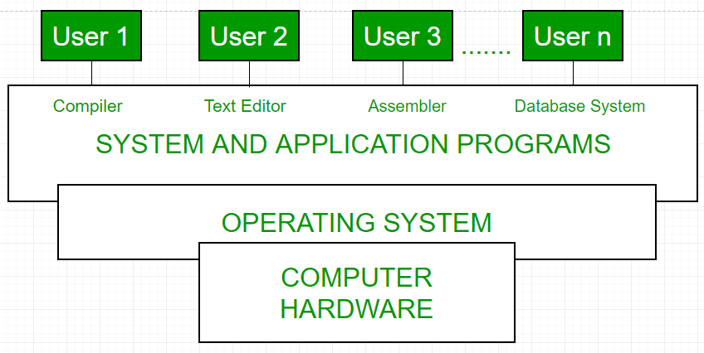
COMPUTER SYSTEM ORGANIZATION

Slide 8
COMPUTER SYSTEM ORGANIZATION
Computer system can be divided into four components:
Hardware – Provides basic computing resources
- CPU, memory, I/O devices
Operating system - Controls and coordinates use of hardware among various applications and users
Application programs – Define the ways in which the system resources are used to solve the computing problems of the users
- Word processors, compilers, web browsers, database systems, video games
Users - People, machines, other computers

Slide 9
03
COMPUTER SYSTEM ARCHITECTURE

Slide 10
COMPUTER SYSTEM ARCHITECTURE
The computer system may be organized in a number of different ways, which we can categorize roughly according to the number of general-purpose processors used.
Single Processor Systems
Multiprocessor Systems
Clustered Systems

Slide 11
SINGLE PROCESSOR SYSTEMS
Most systems use a single processor.
range from PDAs to mainframes
one main CPU capable of executing a general-purpose instruction set
they are managed by the operating system, in that the operating system sends them information about their next task and monitors their status.
Only one process can be executed at a time and then the process is selected from the ready queue. Most general purpose computers contain the single processor systems as they are commonly in use.

Slide 12
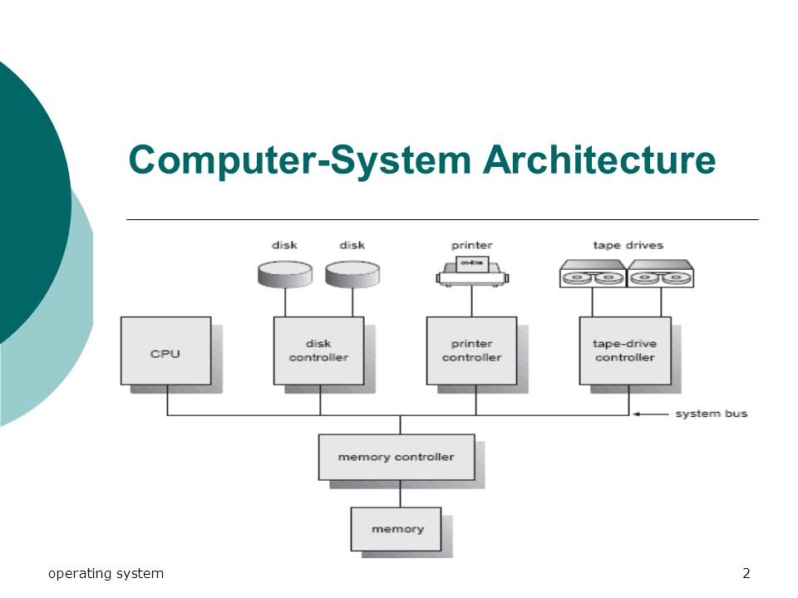
SINGLE PROCESSOR SYSTEMS

Slide 13
MULTIPROCESSOR SYSTEMS
Also known as parallel systems or tightly coupled systems.
Such systems have two or more processors in close communication, sharing the computer bus and sometimes the clock, memory, and peripheral devices.
ADVANTAGES:
1. Increased throughput
- More work done in less time.
2. The economy of scale
- Multiprocessor systems can cost less.
3. Increased reliability
- Failure of one processor will not halt the system, only slow it down.

Slide 14
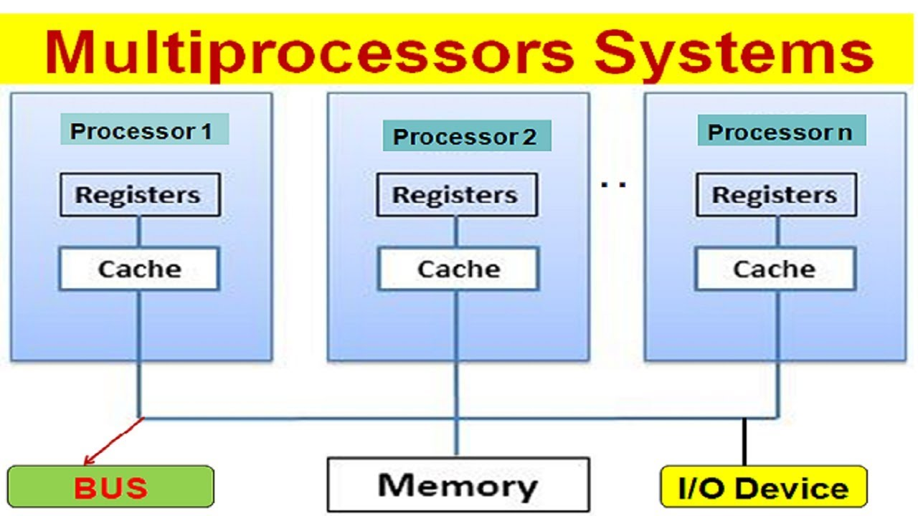
MULTIPROCESSOR SYSTEMS

Slide 15
CLUSTERED SYSTEMS
Another type of multiple-CPU system is the clustered system.
Like multiprocessor systems, clustered systems gather together multiple CPUs to accomplish computational work.
Clustered systems differ from multiprocessor systems, however, in that they are composed of two or more individual systems coupled together.

Slide 16
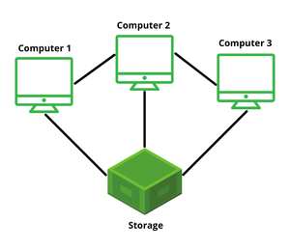
CLUSTERED SYSTEMS

Slide 17
04
OPERATING SYSTEM OPERATIONS

Slide 18
OPERATING SYSTEM OPERATIONS
RESOURCE ALLOCATION
MEMORY MANAGEMENT
FILE MANAGEMENT
COMMUNICATION
SECURITY & PROTECTION
OPERATING SYSTEM OPERATION

Slide 19
05
RESOURCE MANAGEMENT

Slide 20
RESOURCE MANAGEMENT
PROCESSOR
- Next program to be executed?
- Time to be given to each process?
MEMORY
- Efficient use of memory to run as many processes as possible.
I/O DEVICES
- Which device should used particular I/O device?

Slide 21
06
SECURITY AND PROTECTION

Slide 22
RESOURCE MANAGEMENT
Protection – Any mechanism for controlling access of processes or users to resources defined by the OS.
Security – Defense of the system against internal and external attacks.
- Denial-of-service, worms, viruses, identity theft, theft of service
Systems generally first distinguish among users, to determine who can do what:
User identities (user IDs, security IDs) include name and associated number, one per user
User ID then associated with all files, processes of that user to determine access control
Group identifier (group ID) allows set of users to be defined and controls managed, then also associated with each process, file
Privilege escalation allows user to change to effective ID with more rights

Slide 23
07
VIRTUALIZATION

Slide 24
VIRTUALIZATION
Virtualization is technology that lets you create useful IT services using resources that are traditionally bound to hardware. It allows you to use a physical machine's full capacity by distributing its capabilities among many users or environments.
Virtualization enables the hardware resources of a single computer—processors, memory, storage and more—to be divided into multiple virtual computers, called virtual machines (VMs)

Slide 25
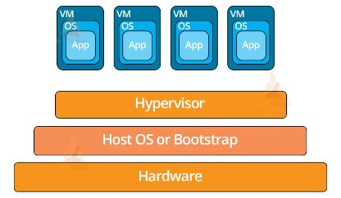
VIRTUALIZATION

Slide 26
VIRTUALIZATION
A hypervisor, also known as a virtual machine monitor or VMM, is software that creates and runs virtual machines (VMs).
A hypervisor allows one host computer to support multiple guest VMs by virtually sharing its resources, such as memory and processing.

Slide 27
COMPUTING ENVIRONMETS
TRADITIONAL
CLUSTER COMPUTING
AUGMENTED
CLIENT-SERVER
DISTRIBUTD SYSTEM
PEER-TO-PEER
CLOUD COMPUTING
REAL-TIME EMBEDDED SYSTEM

Slide 28
TRADITIONAL COMPUTING
In this technique there will be a particular operating system that is going to perform all tasks to that particular computer system. It is like one task is performed by the CPU at a given time and the CPU utilizes the memory that is used only for one task.

Slide 29
CLUSTER COMPUTING
In a computer system, a cluster is a group of homogeneous servers and other resources that act like a single system and enable high availability, load balancing and parallel processing. These systems can range from a two-node system of two personal computers (PCs) to a supercomputer that has a cluster architecture

Slide 30
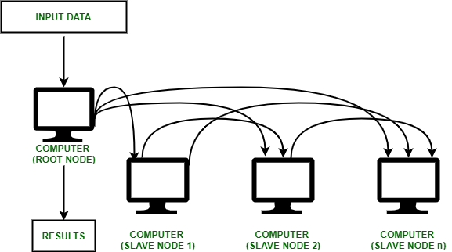
CLUSTER COMPUTING

Slide 31
CLIENT-SERVER
The client-server architecture refers to a system that hosts, delivers, and manages most of the resources and services that the client requests. In this model, all requests and services are delivered over a network, and it is also referred to as the networking computing model or client server network.

Slide 32

CLIENT-SERVER

Slide 33
DISTRIBUTED COMPUTING
Collection of separate, possibly heterogeneous, systems networked together.
Distributed computing is the method of making multiple computers work together to solve a common problem. It makes a computer network appear as a powerful single computer that provides large-scale resources to deal with complex challenges.

Slide 34
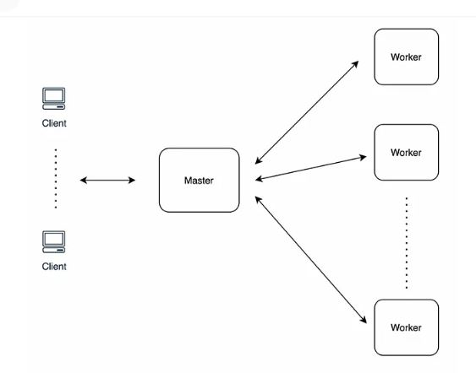
DISTRIBUTED COMPUTING

Slide 35
PEER-TO-PEER
A peer-to-peer (P2P) architecture consists of a decentralized network of peers - nodes that are both clients and servers. P2P networks distribute the workload between peers, and all peers contribute and consume resources within the network without the need for a centralized server.

Slide 36
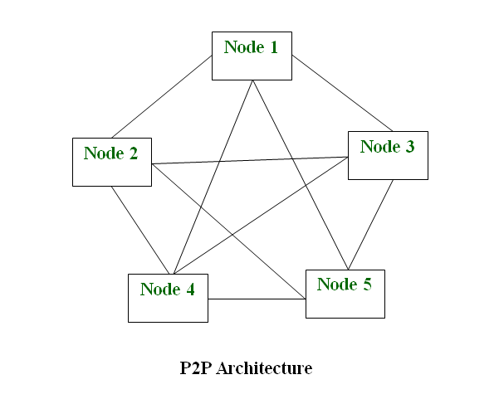
PEER-TO-PEER

Slide 37
CLOUD COMPUTING
Cloud computing is the delivery of computing services—including servers, storage, databases, networking, software, analytics, and intelligence—over the Interne.
Software as a Service (SAAS)
Platform as a Service (PAAS)
Infrastructure as Service (IAAS)

Slide 38
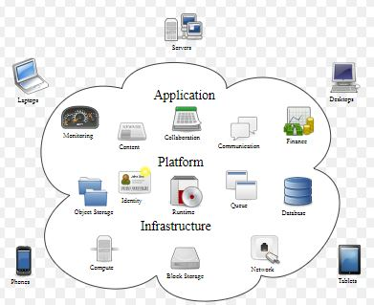
CLOUD COMPUTING

